Slide 1
Section 6.1 Composite Solids
© Copyright all rights reserved to Homework depot: www.BCMath.ca

Slide 2
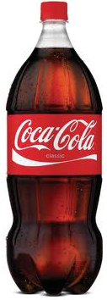
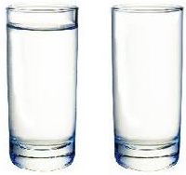
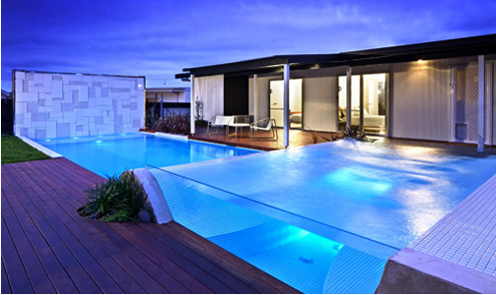
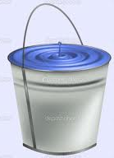
I) Volume of 3D Solids:
The volume of a 3D solid is the amount of space inside
For instance, if we have a cup, the volume is the amount of water inside
There are many real world applications with Volume
Amount of liquid in a container, pool, or bucket
Liquid can be measured in Litres and ml
Volume can be measured in: mm³ ,cm³, or m³
Conversion: 1cm³ = to 1ml
© Copyright all rights reserved to Homework depot: www.BCMath.ca

Slide 3
Volume of a Box:
Suppose you have a bin that measures 3cm by 4cm with a height of 5cm, how many 1cm³ boxes can you fit inside?
Another way to understand volume is to count the number of 1cm³ blocks that you can fit inside
So the volume of the larger box will be 60cm³ because you can fit 60 little 1-cm³ boxes inside
© Copyright all rights reserved to Homework depot: www.BCMath.ca

Slide 4
How to calculate volume?
One way to find the volume of a prism is to first find the area of the base in units² (ie: cm²,mm², or m²)
Then multiply the area of the base by the height of the prism
The height tells us how many layers there are
`
`
`
`
`
Suppose the area of the base is 24cm²
`
The height of each layer is 1cm tall
`
`
`
`
`
`
© Copyright all rights reserved to Homework depot: www.BCMath.ca

Slide 5
Ex: A box is 4cm wide, 5cm long, and 25cm high. How much liquid can it hold? Give your answer in millilitres.
First find the volume of the box in cm³
Get the area of the base:
Multiply the area of the base with the height
Find the volume in millilitres
© Copyright all rights reserved to Homework depot: www.BCMath.ca

Slide 6
Practice: Given the area of the base for each prism, find the volume of the solid:
© Copyright all rights reserved to Homework depot: www.BCMath.ca

Slide 7
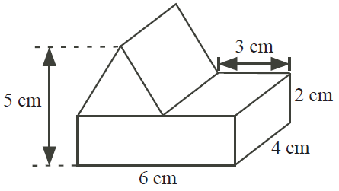
Ex: A triangular prism is placed on a rectangular prism as shown. What is the volume of the combined structure?

Slide 8
Surface Areas & Volumes of Cubes and Rectangular Prisms
All sides and edges in a cube are equal
The volume of a prism is the area of the base multiplied by the height
Height (# of bases)
Area of the base
S.A. & Volume Applet

Slide 9
Surface Areas and Volumes of Cylinders
The base of a cylinder is a circle
The volume of a cylinder is:
The surface area of a cylinder is the area of all the sides

Slide 10
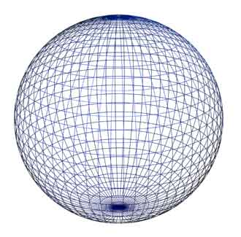
Surface Area and Volume of Spheres
The surface area of a cylinder is equal to the lateral area of a cylinder with the same radius and height
Sphere Applet

Slide 11
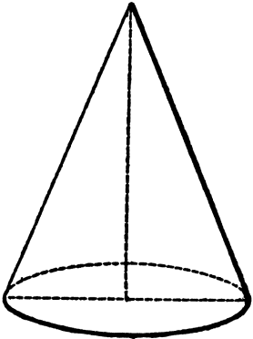
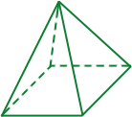
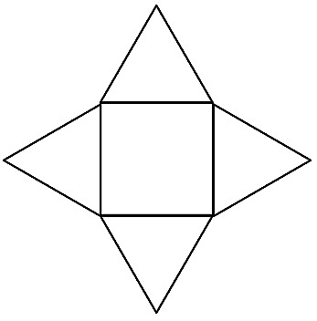
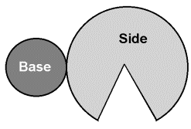
Surface Areas and Volumes of Pyramids
The volume of a pyramid is 1/3 of the volume of a prism with the same base and height
Add the areas
of all the sides

Slide 12
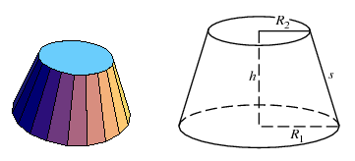
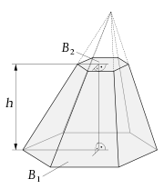
Volume of Frustums
A frustum of a pyramid with the top sliced off
The top and bottom sides must be parallel

